Slide 1
Office of Informatics and Information Governance (OIIG) Strategic Investment Management (SIM) VHA Business Architecture Services (BA)
Current State of VHA Information Modeling
• Focus on VHA Business Information Architecture (BIA)
• How BIA Leverages and Contributes to the FHIM
Bob Bishop, Chief Health Segment Architect
Robert Crawford, Lead Information Architect
August 17, 2016
August 17, 2016

Slide 2

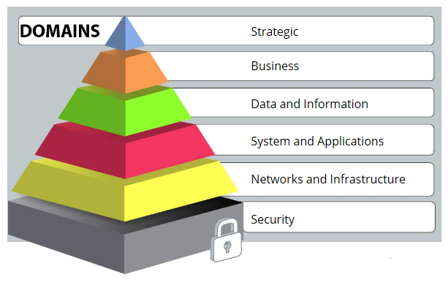
VHA Business Architecture: Health Segment of VA Enterprise Architecture
In accordance with Federal CIO Council guidelines, VHA Business Architecture is a contributor to the overall VA Enterprise Architecture
Health
Segment
Notes:
2
VHA Business Architecture is the Health Segment of VA’s overall Enterprise Architecture which also includes two other segments: Veterans Benefits and National Cemeteries. As the slide shows, VHA Business Architecture is responsible for the strategic, business, and information areas. Note that VHA information architecture is a shared responsibility.

Slide 3
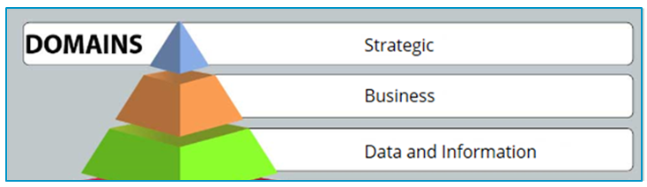
VHA Business Architecture Units
Strategic and Performance Architecture
Business Reference Architecture
Business Process Architecture
Business Information Architecture
Planning and Integration Architecture
Notes:
3
This slides lists the five VHA Business Architecture units, highlighting the three that we will be discussing further.

Slide 4
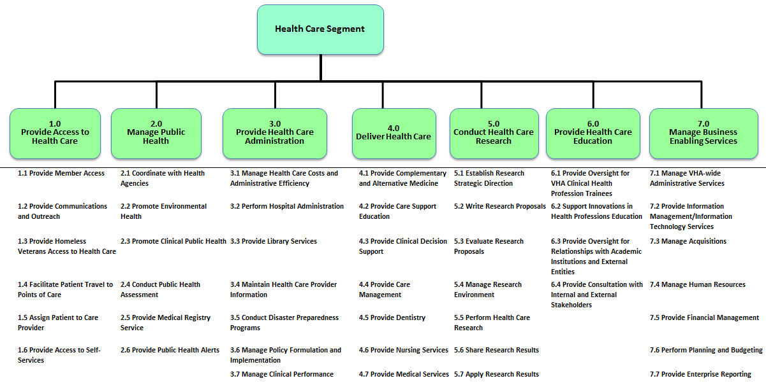
VHA Business Reference Architecture Business Reference Model Business Function Framework
Notes:
The first BA unit we’ll touch on is VHA Business Reference Architecture. The unit’s primary product is the Business Function Framework, which is an functional decomposition of VHA’s business. The Framework has four levels – the first two are shown here. Examples of top level business functions are #3: “Provide Health Care Administration” and #4: “Deliver Health Care”. The business function framework is used in many ways including for strategic planning and for program management.

Slide 5
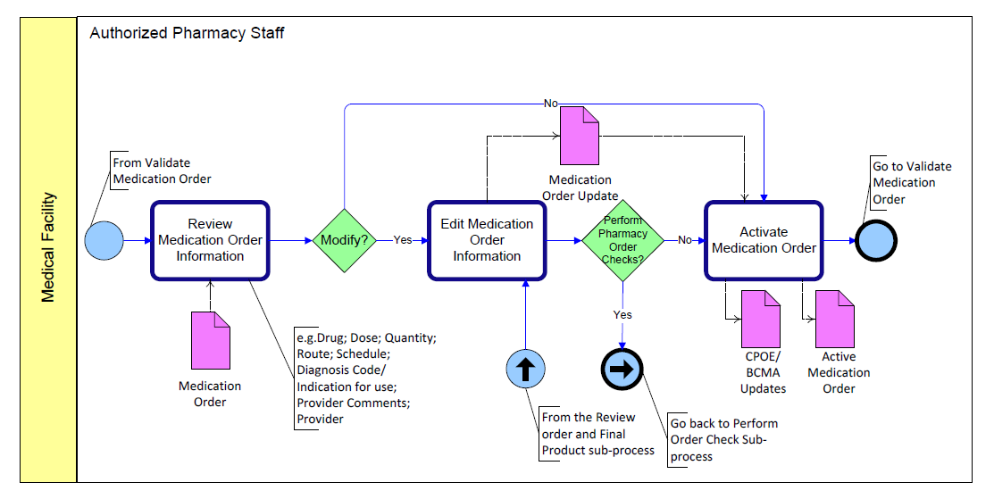
VHA Business Process Architecture Process Model Example “Complete Medication Order”
Notes:
The second BA unit we’ll touch on is VHA Business Process Architecture. The unit’s primary product is business process models, of which there are hundreds, each of which includes sub-process diagrams, one of which is show here. Note the rounded rectangles in this diagram – each rectangle represents an process activity. Also please note the pink document elements – they represent data objects which feed into and/or out of the various activities. The business process models are used in many ways including for system requirements gathering, and for process reengineering.

Slide 6
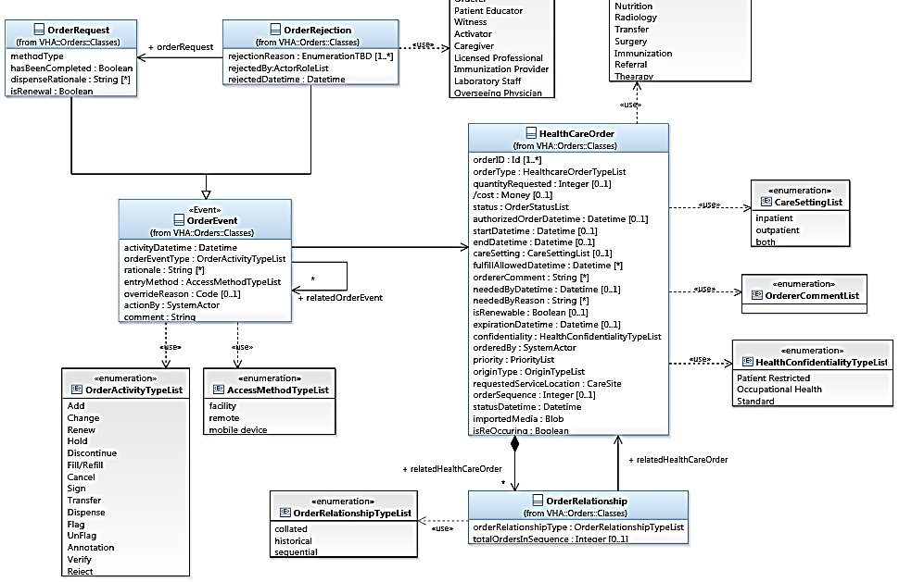
VHA Business Information Architecture Information Model Example “Order Rejection”
Notes:
The third BA unit we’ll touch on is VHA Business Information Architecture. The unit’s primary product is business information models, including VHA’s overarching business information model which we call the “BIM”. The diagram shown here is a tiny subset of the BIM and is called a Normalized Data Object. The blue rectangles are classes and the grey rectangles are value sets defined by the business. The business information models are used in many ways including for data services discovery, data stewardship, data quality, and data consistency.

Slide 7
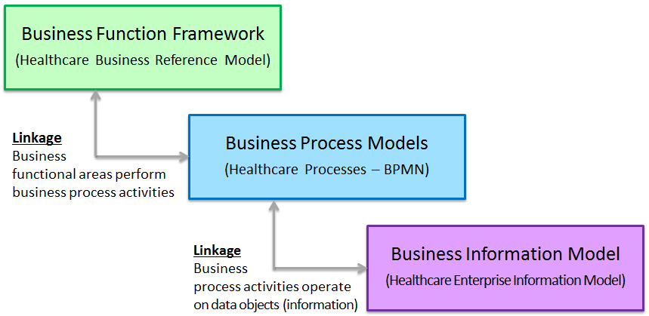
Business Architecture Integration Core Architectural Product Suite
Model-Driven Requirements

Slide 8
VHA Business Information Model (BIM)
The BIM is VHA's authoritative enterprise information model
BIM conceptual model: Major classes and their associations
BIM logical model: All classes, associations, attributes, etc.
Built and matured incrementally, often as part of focused work efforts
For example the recent Pharmacy modernization work effort
Organized into 38 domains
Encompasses clinical, administrative, and financial business areas

Slide 9
Normalized Data Objects (NDO)
NDOs link information model concepts to business processes
Utilize process model data objects
Multiple data objects are “normalized” into a single information model diagram
Example: The data objects Order Entered, Order Updated, and Order Closed are consolidated into a Healthcare Order NDO
NDOs are domain agnostic
NDOs are reusable and updated as each work-effort progresses
NDOs inform IT as to candidate data services

Slide 10
All Information Models Use UML (2.2) Notation
Tooling is Rational Software Architect®
Supports Eclipse plug-ins which are important for MDA
Also used for BPMN modeling
Rational Team Concert® is used for model configuration management

Slide 11
Content of BA Information Models
Classes, attributes, associations, enumerations, and (business) datatypes
Business information only – nothing specific to IT
Value sets as provided by SMEs – in the form of UML enumerations
Tooling is Rational Software Architect®
Supports Eclipse plug-ins which are important for MDA
Also used for BPMN modeling
Rational Team Concert® is used for model configuration management

Slide 12
Business Information Modeling Influences
SMEs
Requirements Documentation
LRPs (Laws, Regulations, Policies)
BIM
VHA Business Information Model
SDO Standards
Process Models
Hybrid Information
Models
Health Operations Documentation (e.g. Job Aids, Guidelines)
FHIM
Federal Health Information Model

Slide 13
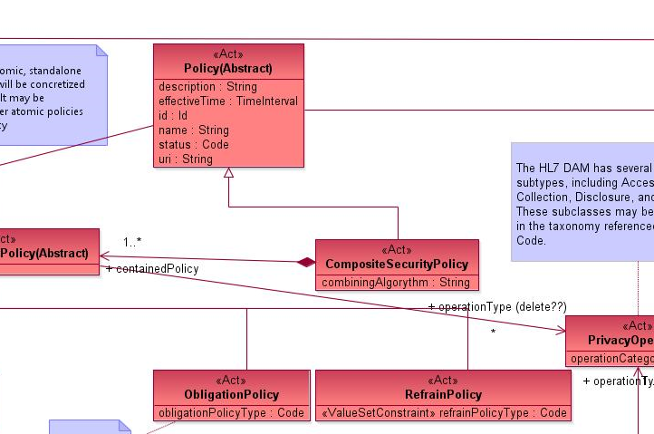
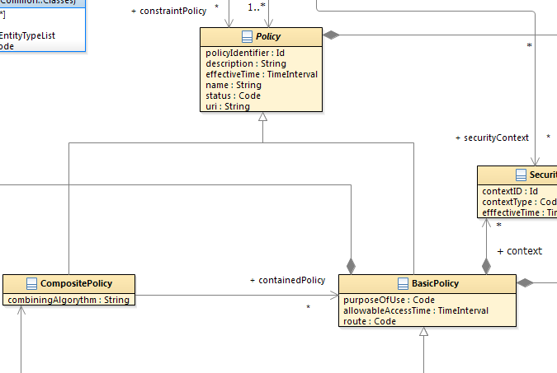
VHA Business Information Modeling Influences How is the FHIM leveraged
FHIM Privacy Domain
VHA Security and Privacy Domain
If the Information Domain under consideration has already been modeled in the FHIM, BIA evaluates the FHIM content for potential matches to VHA information classes. In the above example VHA carefully considered the FHIM Privacy Domain as part of its Security and Privacy work that was performed as part of its iEHR requirements.

Slide 14
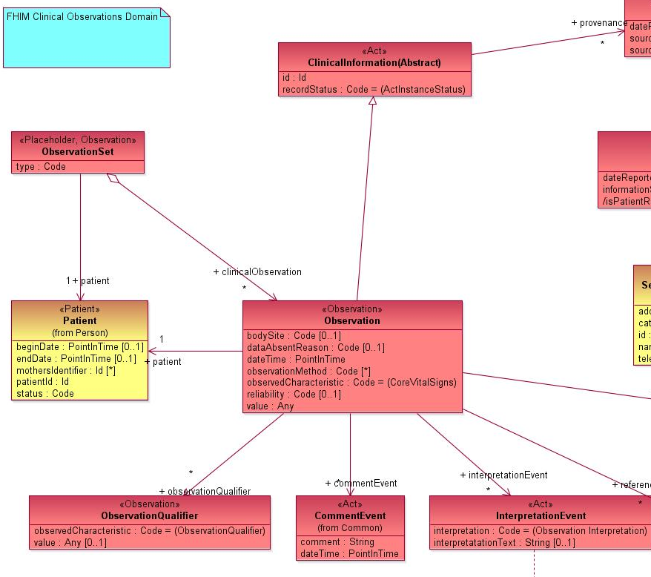
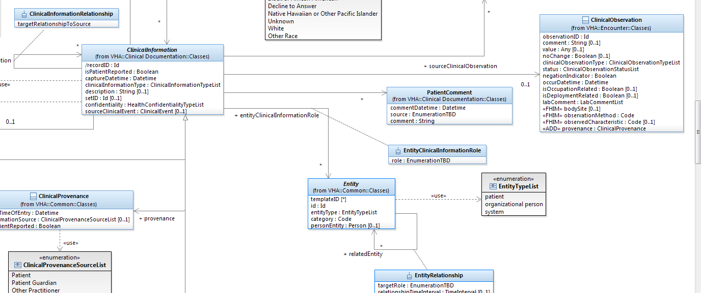
VHA Business Information Modeling Influences How is the FHIM leveraged (Contd)
FHIM Observation Domain
VHA Clinical Observations
In the above example VHA carefully considered the FHIM Observation information pattern as part of its Patient Health Record work that was performed to support multiple VHA work efforts.

Slide 15
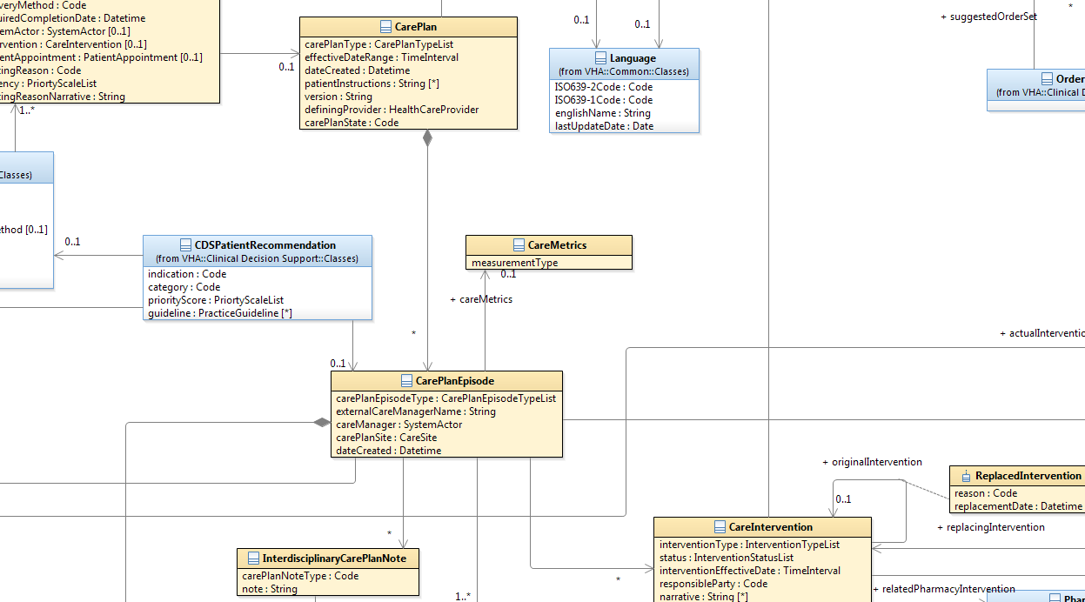
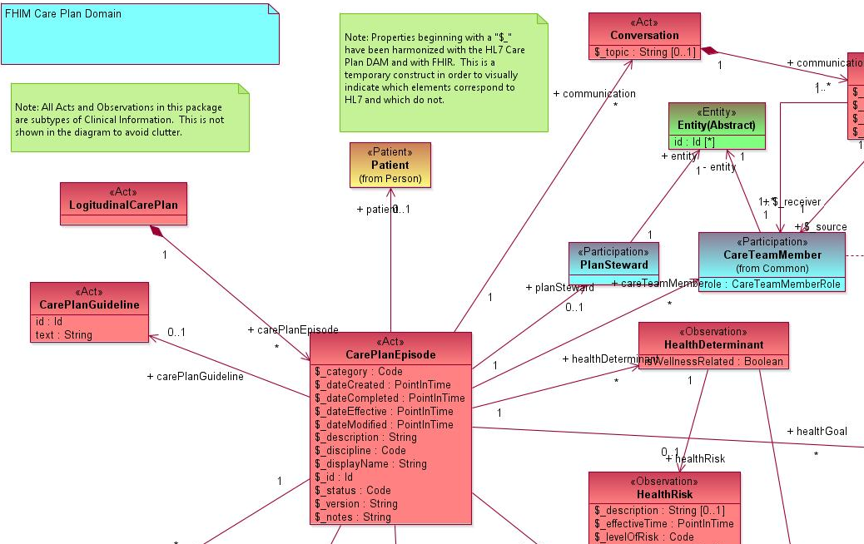
VHA Business Information Modeling Influences How BIA has informed the FHIM
VHA Care Management Domain
FHIM CarePlan Domain
If the Information Domain under consideration was first elaborated by BIA prior to the FHIM, BIA recommends content for potential inclusion in the FHIM model. In the above example VHA had already modeled Care planning during the Care and Disease Management iEHR IPT and provided certain key concepts to the FHIM that was included as part of the FHIM CarePlan domain.

Slide 16
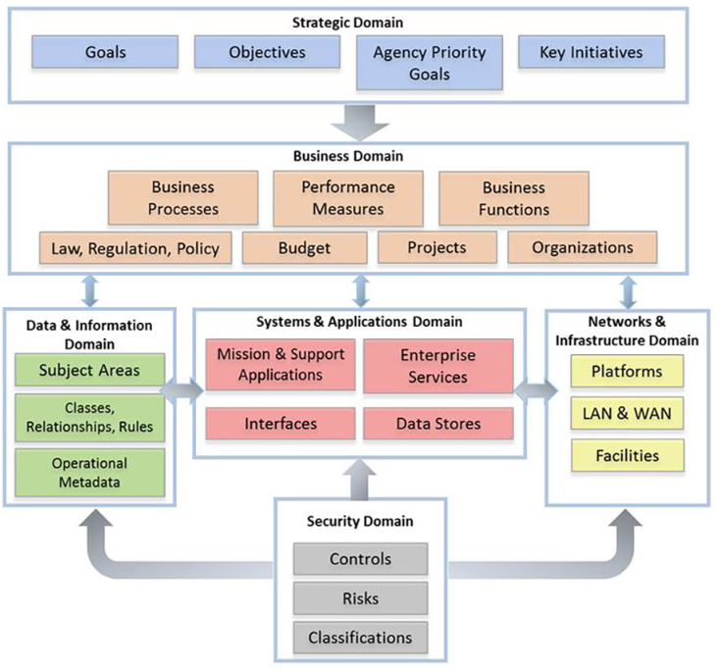
VHA Business Architecture Integration with VA Office of Information & Technology
Notes:
http://vaww.ea.oit.va.gov/enterprise-architecture/business-architecture/

Slide 17
Questions?
Thank you for your time!

